Slide 1
Rounding to any number of decimal places
Estimation and rounding

Slide 2
how to use Oak lessons

Slide 3
I can round numbers to any number of decimal places.

Slide 4
Round − To change a number into another number that is approximately the same value but is easier to work with. E.g. Round 561 to the nearest 10 is 560.

Slide 5

Rounding to any number of decimal places
Rounding to a given number of decimal places
Rounding in a context

Slide 6
Rounding to a given number of decimal places
Round 0.67839 to 1 decimal place.
HMn | TMn | Mn | HTh | TTh | Th | H | T | O | T | H | Th | TTh | HTh | Mh
 |  |  |  |  |  |  |  | 0 | 6 | 7 | 8 | 3 | 9
.
th
th
th
th
th
th
.
7 is greater than 5
Identify the tenths column as this is the 1st decimal place.
Consider the digit in the hundredths column, the column to the right.
Therefore, we increase the tenths digit by 1.
0.67839 = 0.7 (1 d.p.)

Slide 7
Rounding to a given number of decimal places
Round 45.8749 to 2 decimal places.
HMn | TMn | Mn | HTh | TTh | Th | H | T | O | T | H | Th | TTh | HTh | Mh
 |  |  |  |  |  |  | 4 | 5 | 8 | 7 | 4 | 9
.
th
th
th
th
th
th
.
4 is less than 5
Identify the hundredths column as this is the 2nd decimal place.
Consider the digit in the thousandths column, the column to the right.
Therefore, we keep the hundredths digit the same.
45.8749 = 45.87 (2 d.p.)

Slide 8
Rounding to a given number of decimal places
Round 25.3065 to 3 decimal places.
HMn | TMn | Mn | HTh | TTh | Th | H | T | O | T | H | Th | TTh | HTh | Mh
 |  |  |  |  |  |  | 2 | 5 | 3 | 0 | 6 | 5
.
th
th
th
th
th
th
.
5 is exactly halfway
Identify the thousandths column as this is the 3rd decimal place.
Consider the digit in the ten thousandths column, the column to the right.
Therefore, we increase the thousandths digit by 1.
25.3065 = 25.307 (3 d.p.)

Slide 9
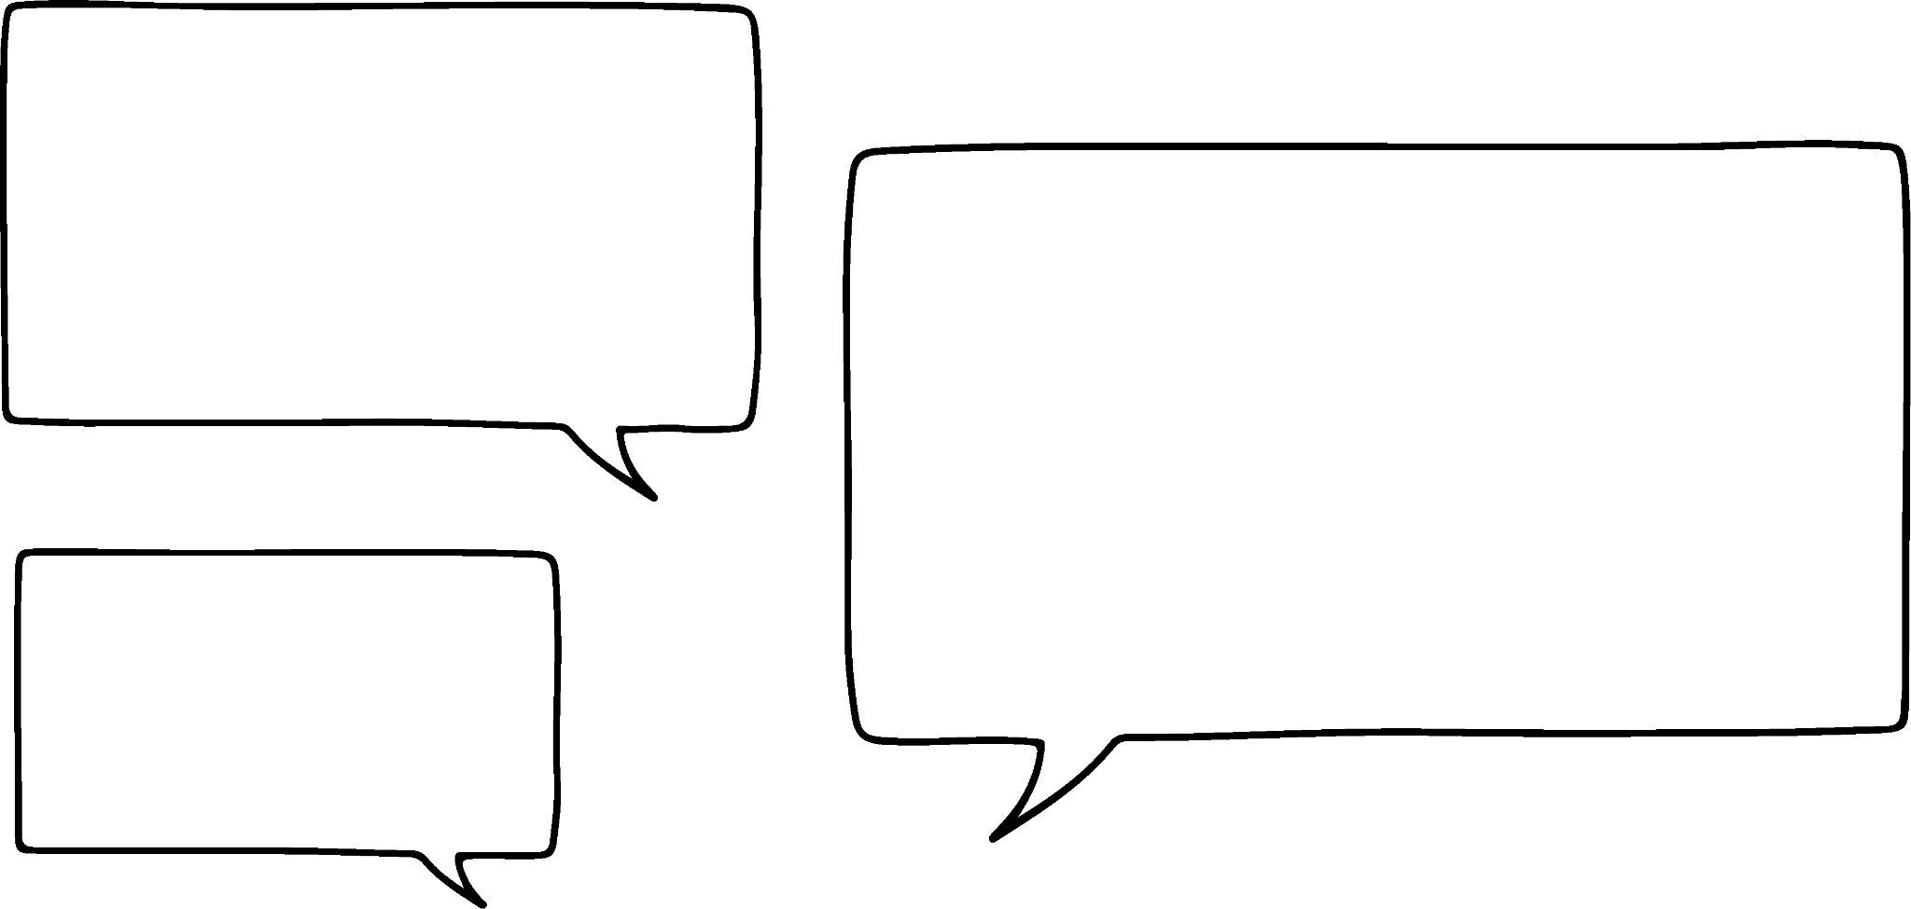
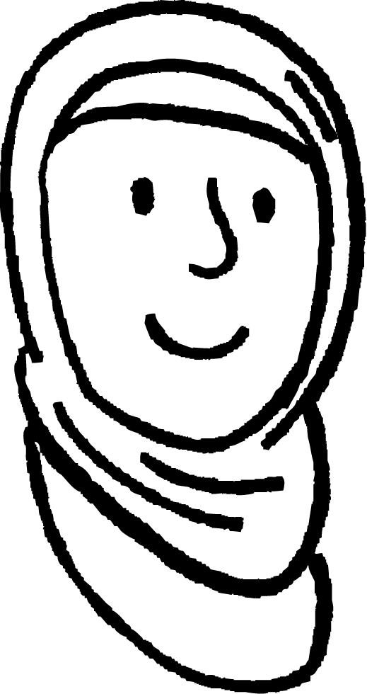
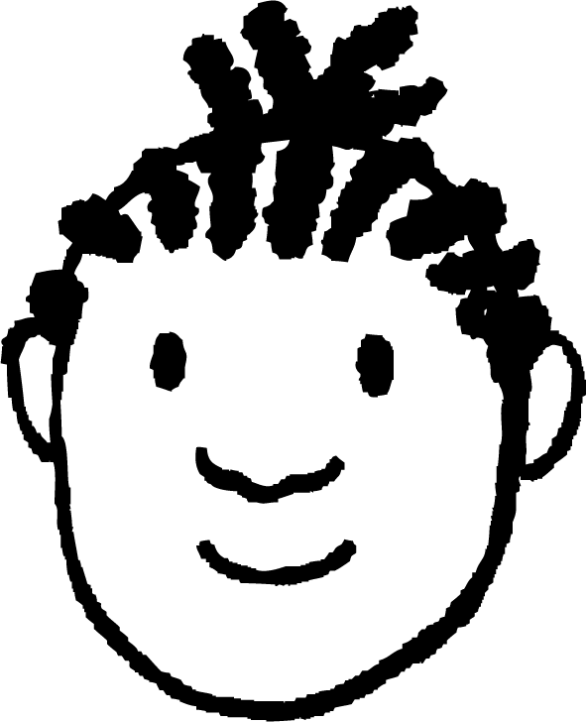
Rounding to a given number of decimal places
Aisha and Jacob are rounding 0.3098 to 3 decimal places.
It is 0.310
It is 0.3010
Aisha
Jacob
Who is correct?
HMn | TMn | Mn | HTh | TTh | Th | H | T | O | T | H | Th | TTh | HTh | Mh
 |  |  |  |  |  |  |  | 0 | 3 | 0 | 9 | 8
.
th
th
th
th
th
th
.
Aisha is correct, adding 1 thousandth to 0.309 is 0.310
Jacob has increased 9 to 10 and not exchanged the 10 thousandths for 1 hundredth.

Slide 10
Rounding to a given number of decimal places
Complete the following table:
Number | to 1 d.p. | to 2 d.p. | to 3 d.p.
14.25342
765.3246
2035.83716
7.658192
82.82926
0.63492
0.08739
0.2995

Slide 11
Rounding to a given number of decimal places
2) Using the clues, find the numbers being described:
Clue 1 − I am between 2 and 3.
Clue 2 − I have 3 digits after the decimal point.
Clue 3 − When rounded to 2 decimal places I am 2.88
Clue 4 − My hundredths digit is greater than my thousandths digit.
Clue 5 − The difference between my tenths and thousandths digits is 2.
I am .

Slide 12
Rounding to a given number of decimal places
2) Using the clues, find the numbers being described:
b) Clue 1 − I am between 1 and 2.
Clue 2 − I have 3 digits after the decimal point.
Clue 3 − When rounded to 1 decimal place I am 1.9
Clue 4 − When rounded to 2 decimal places I am 1.90
Clue 5 − The sum of my tenths and thousandths column is 13.
I am .

Slide 13
Rounding to a given number of decimal places
2) Using the clues, find the numbers being described:
c) Clue 1 − I am between 0 and 1.
Clue 2 − I have 3 digits after the decimal point.
Clue 3 − When rounded to 1 decimal place I am 0.1
Clue 4 − When rounded to 2 decimal places I am 0.08
Clue 5 − My hundredths column is double my thousandths column.
I am .

Slide 14
Rounding to a given number of decimal places
Complete the following table:
Number | to 1 d.p. | to 2 d.p. | to 3 d.p.
14.25342 | 14.3 | 14.25 | 14.253
765.3246 | 765.3 | 765.32 | 765.325
2035.83716 | 2035.8 | 2035.84 | 2035.837
7.658192 | 7.7 | 7.66 | 7.658
82.82926 | 82.8 | 82.83 | 82.829
0.63492 | 0.6 | 0.63 | 0.635
0.08739 | 0.1 | 0.09 | 0.087
0.2995 | 0.3 | 0.30 | 0.300

Slide 15
Rounding to a given number of decimal places
2) Using the clues, find the numbers being described:
Clue 1 − I am between 2 and 3.
Clue 2 − I have 3 digits after the decimal point.
Clue 3 − When rounded to 2 decimal places I am 2.88
Clue 4 − My hundredths digit is greater than my thousandths digit.
Clue 5 − The difference between my tenths and thousandths digits is 2.
I am 2.876

Slide 16
Rounding to a given number of decimal places
2) Using the clues, find the numbers being described:
b) Clue 1 − I am between 1 and 2.
Clue 2 − I have 3 digits after the decimal point.
Clue 3 − When rounded to 1 decimal place I am 1.9
Clue 4 − When rounded to 2 decimal places I am 1.90
Clue 5 − The sum of my tenths and thousandths column is 13.
I am 1.904 or 1.895

Slide 17
Rounding to a given number of decimal places
2) Using the clues, find the numbers being described:
c) Clue 1 − I am between 0 and 1.
Clue 2 − I have 3 digits after the decimal point.
Clue 3 − When rounded to 1 decimal place I am 0.1
Clue 4 − When rounded to 2 decimal places I am 0.08
Clue 5 − My hundredths column is double my thousandths column.
I am 0.084

Slide 18
Rounding to any number of decimal places
Rounding to a given number of decimal places
Rounding in a context

Slide 19
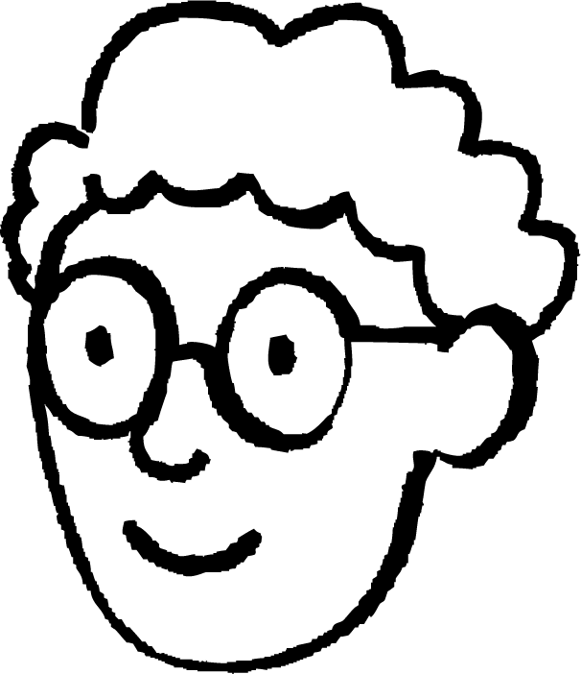
Rounding in a context
In 2022, at the FINA World Championships (25 m), the headlining event was the last race: the men’s 4 × 100 m. The result of the race was a dead heat, meaning that USA and Australia both got the gold medal and a new world record.
I think you are right Aisha. Maybe if the time had been measured to the nearest thousandth of a second there would be a difference.
I think that if they could measure the time to a greater degree of accuracy it probably would not have been.
The new world record was 3:18.98
Do you think it was actually a dead heat?
Aisha
Limitations of measuring can have an affect on outcomes.
Alex

Slide 20
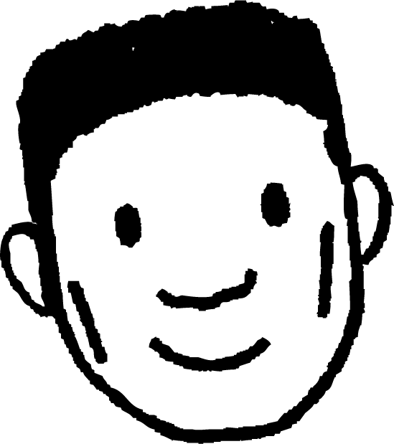
Rounding in a context
Lucas is working on a project. He has 3 m of material and cuts it into 30 cm pieces.
How many pieces can he make?
300 cm ÷ 30 cm = 10
Why might Lucas’ last piece be smaller than the rest?
When measuring there are frequently errors. Even very small errors can become much larger if repeated.
My last piece is less than 30 cm.
Lucas

Slide 21
Rounding in a context
We’ll now take a look at what effect this could have on Lucas’ pieces of material.
Imagine Lucas cuts each of the first 9 pieces 1 mm longer.
What will the length of the final piece be?
My ruler only allows me to measure to the nearest millimetre.
300 − 9 × 30.1 = 29.1 cm
We can see that this very small error of 1 mm has a bigger impact on the size of the last piece.
Lucas

Slide 22
Rounding in a context
300 − 9 × 29.9 = 30.9 cm
Again, we can see that this very small error of 1 mm has a bigger impact on the size of the last piece of material.
What happens when I cut each of the first 9 pieces 1 mm shorter than I should?
Lucas

Slide 23
Rounding in a context
3.24 m
This area needs to be carpeted.
Let’s take a look at Aisha, Lucas and Jacob’s workings.
£5.29 per m²
1.26 m
Aisha’s Workings
3 × 1 = 3 m²
3 × 5.29 = £15.87
Why has Aisha rounded the dimensions of the room?
The carpet is sold in square metres so she has rounded each dimension to the nearest metre.
How do you know that this area of carpet will not cover the whole room?
Aisha has rounded both measurements and both have gotten smaller.

Slide 24
Rounding in a context
3.24 m
This area needs to be carpeted.
Let’s take a look at Aisha, Lucas and Jacob’s workings.
£5.29 per m²
1.26 m
Lucas’ Workings
3.24 × 1.26 = 4.0824 m²
4.0824 × 5.29 = £21.595896
Why is Lucas’ method not appropriate?
Giving the area of the floor to 4 decimal places is not appropriate. Carpet would not be measured to this degree of accuracy.
What about the cost?
It would need to be rounded to 2 decimal places.

Slide 25
Rounding in a context
3.24 m
This area needs to be carpeted.
Let’s take a look at Aisha, Lucas and Jacob’s workings.
£5.29 per m²
1.26 m
Jacob’s Workings
3.24 × 1.26 = 4.08 m²
4.08 × 5.29 = £21.58
Jacob’s method is the most appropriate.
He has given the area correct to 2 decimal places.
Jacob’s cost has been given to 2 decimal places.
Generally, answers are given to the same degree of accuracy as the values in the question, unless otherwise specified in the question.

Slide 26

Rounding in a context
Which option shows the appropriate calculations to calculate the cost to carpet the room?
5.92 m
£6.50 per m²
4.1 m
5.92 × 4.1 = 24.272 m²
24.272 × 6.5 = £157.768
5.92 × 4.1 = 24.27 m²
24.27 × 6.5 = £157.76
6 × 4 = 24 m²
24 × 6.5 = £156

Slide 27
Rounding in a context
3 friends go out for lunch and spend £25. They decide that there are 3 different ways they can pay.
a) Write down the pros and cons of the different ways.
i) Round the cost to the nearest £10 and split the bill.
ii) Split the bill between the 3 of them, round this to the nearest pound and each pay that amount.
iii) Split the bill between the 3 of them, round to 2 decimal places and each pay that amount.
b) What should they do to pay for the lunch?

Slide 28
Rounding in a context
2) Work out the cost of carpeting the following:
a)
b)
7.2 m
£6.25 per m²
6.8 m
5.1 m
4.2 m
£5.95 per m²
2.84 m
8.08 m

Slide 29
Rounding in a context
3) Lucas, Aisha and Jacob take part in 800 m on sports day. The teacher recorded their times to the nearest minute.
Here are their times:
Lucas Aisha Jacob
3 minutes 3 minutes 3 minutes
Was rounding to the nearest minute a suitable degree of accuracy?
The teacher then decides to record their times to the nearest hundredth of a second. Is this an appropriate degree of accuracy?

Slide 30
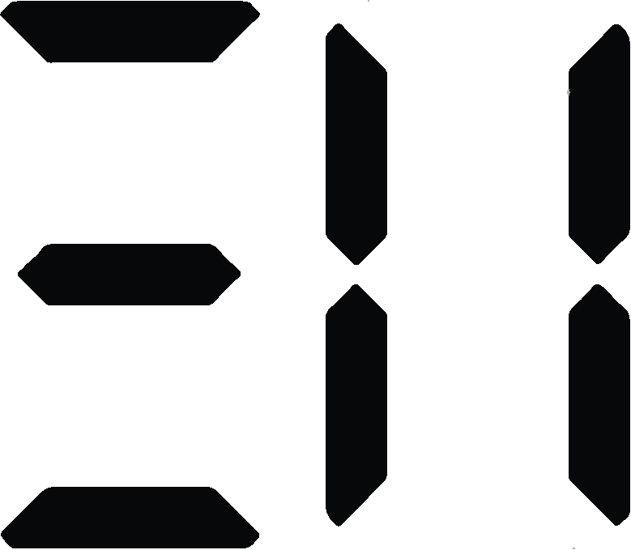
Rounding in a context
Here are their exact times:
Lucas Aisha Jacob
c) Was it necessary to record the times to the nearest 100th of a second?

Slide 31
Rounding in a context
3 friends go out for lunch and spend £25. They decide that there are 3 different ways they can pay.
a) Write down the pros and cons of the different ways.
i) Round the cost to the nearest £10 and split the bill.
£25 ≈ £30 (to the nearest ten)
£30 ÷ 3 = £10
They pay £10 each.
They cover the cost of lunch but pay £5 more than they needed to.

Slide 32
Rounding in a context
3 friends go out for lunch and spend £25. They decide that there are 3 different ways they can pay.
a) Write down the pros and cons of the different ways.
ii) Split the bill between the 3 of them, round this to the nearest pound and each pay that amount.
£25 ÷ 3 = £8 (to the nearest pound)
£8 × 3 = £24
It is easy to work out but they are £1 short on the cost of lunch.

Slide 33
Rounding in a context
3 friends go out for lunch and spend £25. They decide that there are 3 different ways they can pay.
a) Write down the pros and cons of the different ways.
iii) Split the bill between the 3 of them, round to 2 decimal places and each pay that amount.
£25 ÷ 3 = £8.33 (to 2 d.p.)
£8.33 × 3 = £24.99
They each pay the same but they are 1 p short on the cost of lunch.

Slide 34
Rounding in a context
3 friends go out for lunch and spend £25. They decide that there are 3 different ways they can pay.
b) What should they do to pay for the lunch?
They should divide the cost by 3 but round up to the nearest penny.

Slide 35
Rounding in a context
2) Work out the cost of carpeting the following:
a)
b)
7.2 m
£6.25 per m²
7.2 × 6.8 = 49.0 m²
49.0 × 6.25 = £306.25
6.8 m
5.1 m
8.08 × 4.2 − 2.98 × 1.36 = 29.88 m²
29.88 × 5.95 = £177.79
4.2 m
£5.95 per m²
2.84 m
8.08 m

Slide 36
Rounding in a context
3) Lucas, Aisha and Jacob take part in 800 m on sports day. The teacher recorded their times to the nearest minute.
Here are their times:
Lucas Aisha Jacob
3 minutes 3 minutes 3 minutes
Was rounding to the nearest minute a suitable degree of accuracy? No, because the times were all the same.
The teacher then decides to record their times to the nearest hundredth of a second. Is this an appropriate degree of accuracy? Yes, this should definitely separate the pupils.

Slide 37
Rounding in a context
Here are their exact times:
Lucas Aisha Jacob
c) Was it necessary to record the times to the nearest 100th of a second?
It was not necessary, as you could tell from the tenths of a second.

Slide 38
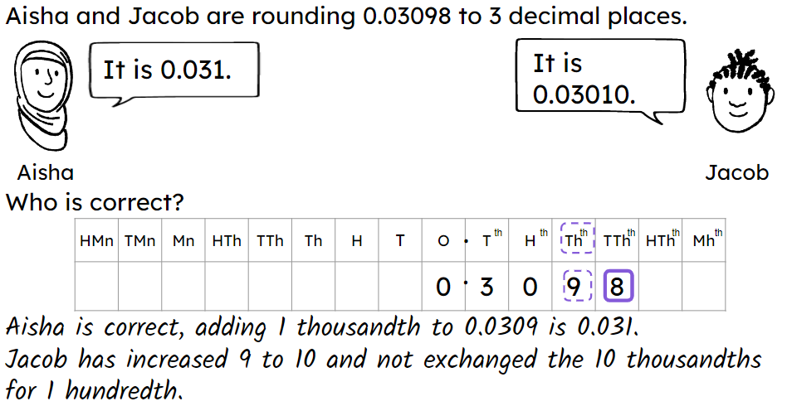
Rounding to any number of decimal places
A place value table is useful when rounding to decimal places.
Take care when the digit in the column that needs altering is a 9. E.g.
Limitations of measuring can have an effect on outcomes.
Generally, answers are given to the same degree of accuracy as the values in the question, unless otherwise specified in the question.

Slide 39

© Oak National Academy 2024.
Produced in partnership with Mathematics in Education and Industry.
Licensed on the Open Government Licence v3.0, except where otherwise stated. See Oak terms and conditions.

